Slide 1
Ghost Photography
Doug Hecker
Richard Turnmire
Sam Watkins
Matt Weirich

Slide 2
Doug Hecker
Our Lead Data Engineer for Project
Designed all interactions to the Database using ADO.net to MS SQL Server
Designed and implemented the Data, Model, and Test Projects
Implemented Microsoft Identity for security

Slide 3
Richard Turnmire
Software Developer
Expertise in .Net/C#
Designed and custom wrote a custom tag cloud model and implemented it into the front end
Wrote and implemented search functionality for the website

Slide 4
Samwise Watkins
Designed and implemented code for the
Developed the code to get CkEditor onto the page as well as into the database
Implemented Richard’s file upload into the Admin pages
Implemented Security into the Admin pages to keep them secure

Slide 5
Matt Weirich
Software Engineer
Designed the Database ERD and created database
Created the sample data and first round of stored procedures
Created Wireframes to be implemented for UI
Designed and implemented the Wireframes and created the front end user interface
Helped with each part of project and solved problems for each member of the project

Slide 6
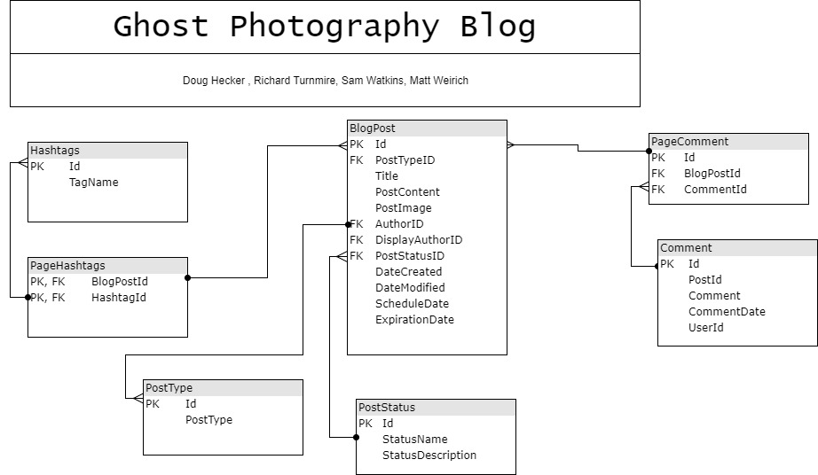
Database Design

Slide 7
Database Sprocs & Testing
We designed the database with the intention of having users log in in order to post comments.
Matt started with the design and implemented the first basic data and design, Doug took over the data portion and implemented more SPROCS and data
We extensively tested each SPROC and their functionality into the data layer of our C# project.

Slide 8
Technologies Used
DrawIO for the Database ERD
Mockflow for wireframes
Microsoft Identity for enabling users and roles
MS SQL Server for our database
C#/.NET primary backend technology (Very Suprising)
FrontEnd Tech
jQuery
HTML
Customized CSS
Bootstrap
CkEditor (WYSIWYG) Content creator

Slide 9
User Interface
WireFrames were designed by Matt, we wanted to ensure that each Blog post was easy to read and navigate. To ensure that each comment was distinct and we could see who posted.
Comments, while not fully implemented, will only be able to posted to by a user and not by the general public with the functionality to be deleted by the Admin

Slide 10
Add & Editing Blog Posts
We Decided to go with CKEditor instead of TinyMCE as it has a bit more functionality and very customizeable by the developer. We could always add more if the client desired
Writers can only Write blog posts, but the Admin (Ms. Z Fantastic) will have to approve posts before they are available to view to the general public

Slide 11
Image Upload and TagCloud
Richard custom wrote and implemented the tag cloud and the functionality
Richard also did all of the code for the image upload.

Slide 12
ToDo
Functionality we would still like to implement:
Only logged in users being able to post to the site (we’re close, but not quite there)
Finish search
Implementing the Static pages and making them link into the Header

